Slide 1


Self Discipline
Prepared by the research team

Slide 2
Agenda
01
What is Self discipline
02
10 principles of self discipline
03
10 Habits of self discipline
04
preparing to do lists
Reality Check

Slide 3
Learning Outcomes
After the completion of this class students would be able to:
Demonstrate the basic knowledge and understanding of self discipline.
Explain and use 10 principles of self discipline.
Share and develop 10 habits of self discipline.
Prepare every day to do list based on priorities and urgencies, developing a more organized personality.

Slide 4
At the heart of any successful person, is self-discipline
Whether it’s success in their personal lives or their professional lives, it all starts with an inherent ability for self-control through discipline.
Your thoughts,
Your emotions,
Your behaviors,
And your habits, all of them must be kept in check.
Famous Marshmallow experiment – longitudinal study

Slide 5
Aristotle once said, “Good habits formed at youth make all the difference.”
More recently, Jim Rohn claimed “Discipline is the bridge between goals and accomplishment.”
And Robert Kiyosaki asserted that “Confidence comes from discipline and training.”

Slide 6
Q. But how is discipline created or formed?
Q. What allows one person to exert what seems like total and full control over their behaviors and their actions, while others hesitate and fail?
Q. How can one person be so conscious of what they do on a daily basis, while others simply throw caution to the wind?
The answer to those questions lies in our habits. Since 40% of our behavior is habit-driven, if you want to control your ability to be self-disciplined, you have to control your habits.

Slide 7
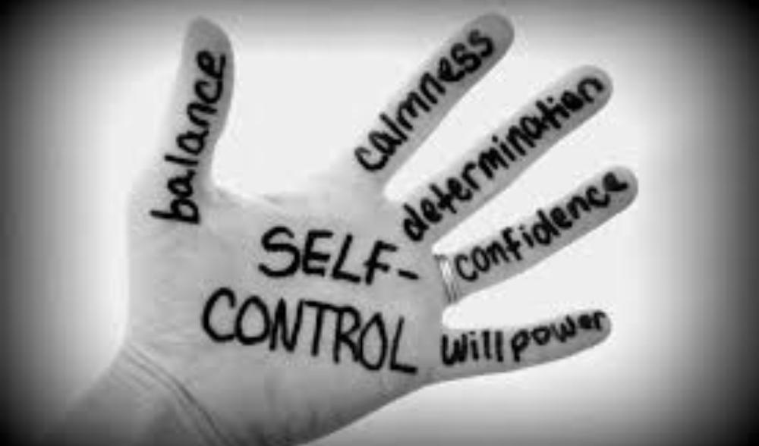

Slide 8
10 principles of self discipline
1. The Discipline of Clear Thinking. Take time to think through critical issues and problems in your life.
2. The discipline of daily Goal-setting: Before you start your day, rewrite your top ten goals in the present tense as though you had already achieved them.
3. The discipline of daily Time Management: The more you plan, the better you will use time, and you will accomplish more.
4. The discipline of Courage: Identify one fear in your life. Then confront it by doing whatever it takes to overcome it.
5. The discipline of excellent health habits: Eat healthy foods, exercise daily. If you do any activity for 21 days, it will become a habit and change your life.

Slide 9
Principles of self discipline (Contd.)
6. The discipline of Savings and Investing: . Delay major purchases for 30 days. Pay cash for as many things as possible.
7. The discipline of Hard Work: Develop a reputation of being a hard worker.
8. The discipline of Continuous Learning: Work on yourself as if your future de-pends on it, because it does!
9. The discipline of Persistence: The greatest test of self-discipline is when you persist in the face of adversity and you drive yourself forward to complete your task 100%, no matter how you feel.
10. The discipline of Self-Control: Learn to say “No” to your destructive feelings,

Slide 10
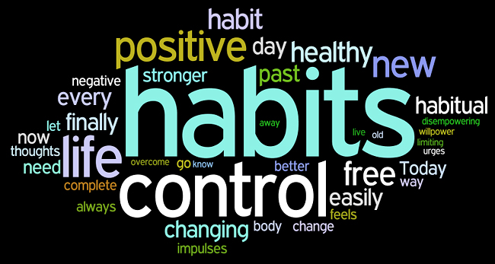
Habits
But where do habits come from and how are they developed?
And why is that when we try to change our habits by either breaking bad habits or building good habits, we only follow through for so long before we give up and revert to our old ways?

Slide 11

Neural pathways help to automate behavior that’s constantly repeated in an effort to reduce
conscious-processing power in the mind. This allows the mind to focus on other things that
might be going on. This stems from our early days as humans, and is part of our genetic makeup, allowing for a more efficient mind that can be used towards many other things rather than the
Ordinary and routine things.

Slide 12

10 habits of Self Discipline
1. Gratitude
We spend far too much time wanting things. The habit of gratitude helps move us away from constantly wanting what we don’t have, and towards appreciating what we do have.
The effects of gratitude are far-reaching. From improving our mental health, to our emotional wellbeing, and our spirituality, gratitude can do so much. But most importantly, it helps to move us away from a state of lack and towards a state of abundance.
When we live in a state of lack, it becomes downright impossible to focus on being disciplined and achieving our goals. We spend so much of our mental capacity on worrying about what we don’t have and living in a state of fear that we forget about what we do have.

Slide 13
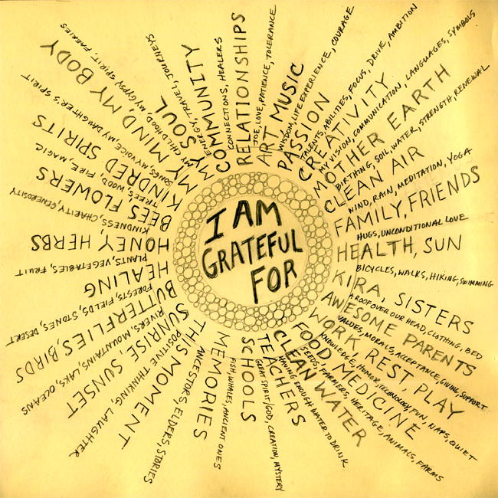

Slide 14

10 habits of Self Discipline (Cont’d)
2. Forgiveness
When we spend a large portion of our days in a state of anger, regret, or guilt, we create more problems than we do solutions. Hate and anger consumes far more energy than love and forgiveness. When we forgive, we learn to let go of certain things.
Without the habit of forgiveness, we couldn’t achieve self-discipline. We’re too worried about how someone wronged us to even focus on discipline or achieving our goals.
If someone hurt you, learn to forgive them. It doesn’t necessarily mean you have to forget. Just forgive and release that negative energy back in to the universe.

Slide 15


Slide 16
10 habits of Self Discipline (Contd.)
3. Meditation:
Meditation helps to put our minds at ease. It provides us with a spiritual centeredness that acts as an avenue of growth. When we meditate, we cancel out the noise, so to speak, and realize that we’re just one of very many connected beings in this universe.
Meditation also has a big impact on our ability to be self-disciplined. It clears the mind’s palette, and sets the right tone for the day. It helps to improve our mental, emotional, physical, and spiritual health all at once, allowing you to reap some of the biggest results for minimal time invested.
Meditation doesn’t take long. It can be done in 10 or 15 minutes.

Slide 17
10 habits of Self Discipline (Contd.)
4. Active goal setting:
With passive goal setting, you set goals in your mind. They’re passive because they lack concrete details. You haven’t properly defined them so they live in the abstract.
Active goals are different. With active goals, they’re written out. They have a profound meaning. They’re specific and measurable. And you have a plan towards their attainment. When we set long-term goals in this manner, and we also engage in active goal setting on a daily basis, it’s far easier to achieve our dreams.
Active goal setting instills discipline because it gives us direction. It also helps us to avoid distractions by seeing just what needs to be done in a given day. Without active goals, we’re left like a ship without a sail stuck in stormy waters.
To set active goals, first you must set some long-term goals. If you have long-term goals, then you need to engage in monthly, weekly, and daily goal setting and planning. And you also have to actively track your progress towards your goals.

Slide 18
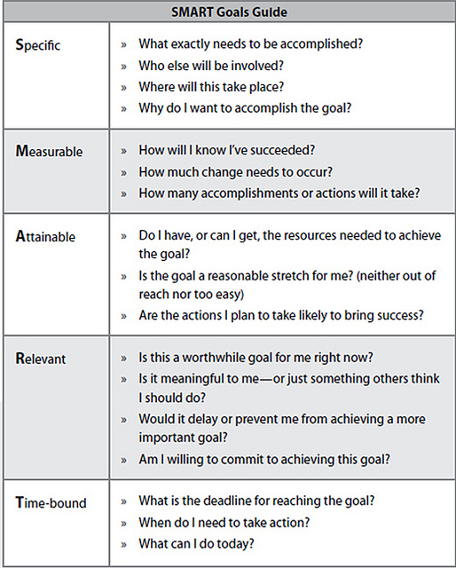
10 habits of Self Discipline (Contd.)

Slide 19
Activity
Q. Form a smart goal related to your course.

Slide 20

10 habits of Self Discipline (Contd.)
5. Eat Healthy
What most people don’t realize is that the human body spends a large portion of its energy processing and digesting foods (10-25% of it). When the diet is rich in carbohydrates, fats, and even proteins, the body is using more energy to process that food, some of which is largely useless to us.
Raw foods and fruits offer the biggest boost for energy because they require less energy to process and provide more energy for usage after the fact.
Food can change the neurochemical makeup of the brain, and has a large influence on the mind-body connection. Opt for raw, healthy, and organic foods when you can and limit your intake of junk

Slide 21
10 habits of Self Discipline (Contd.)
6. Sleep
It’s important to get at least 6 hours of sleep, no matter what. Try not to drink too much caffeine at least 5 hours before bedtime so that you don’t interrupt your natural sleep cycle. Stay away from too many toxins throughout the day such as alcohol, cigarettes, or prescription medicine, if it can be avoided.
Overall, the benefits of getting enough sleep are far-reaching. Aside from helping you to be more disciplined, it will improve your memory, curb inflammation and pain, lower stress, spur your creativity, improve your grades, sharpen your attention, help you avoid depression, and limit your chances for accidents.

Slide 22
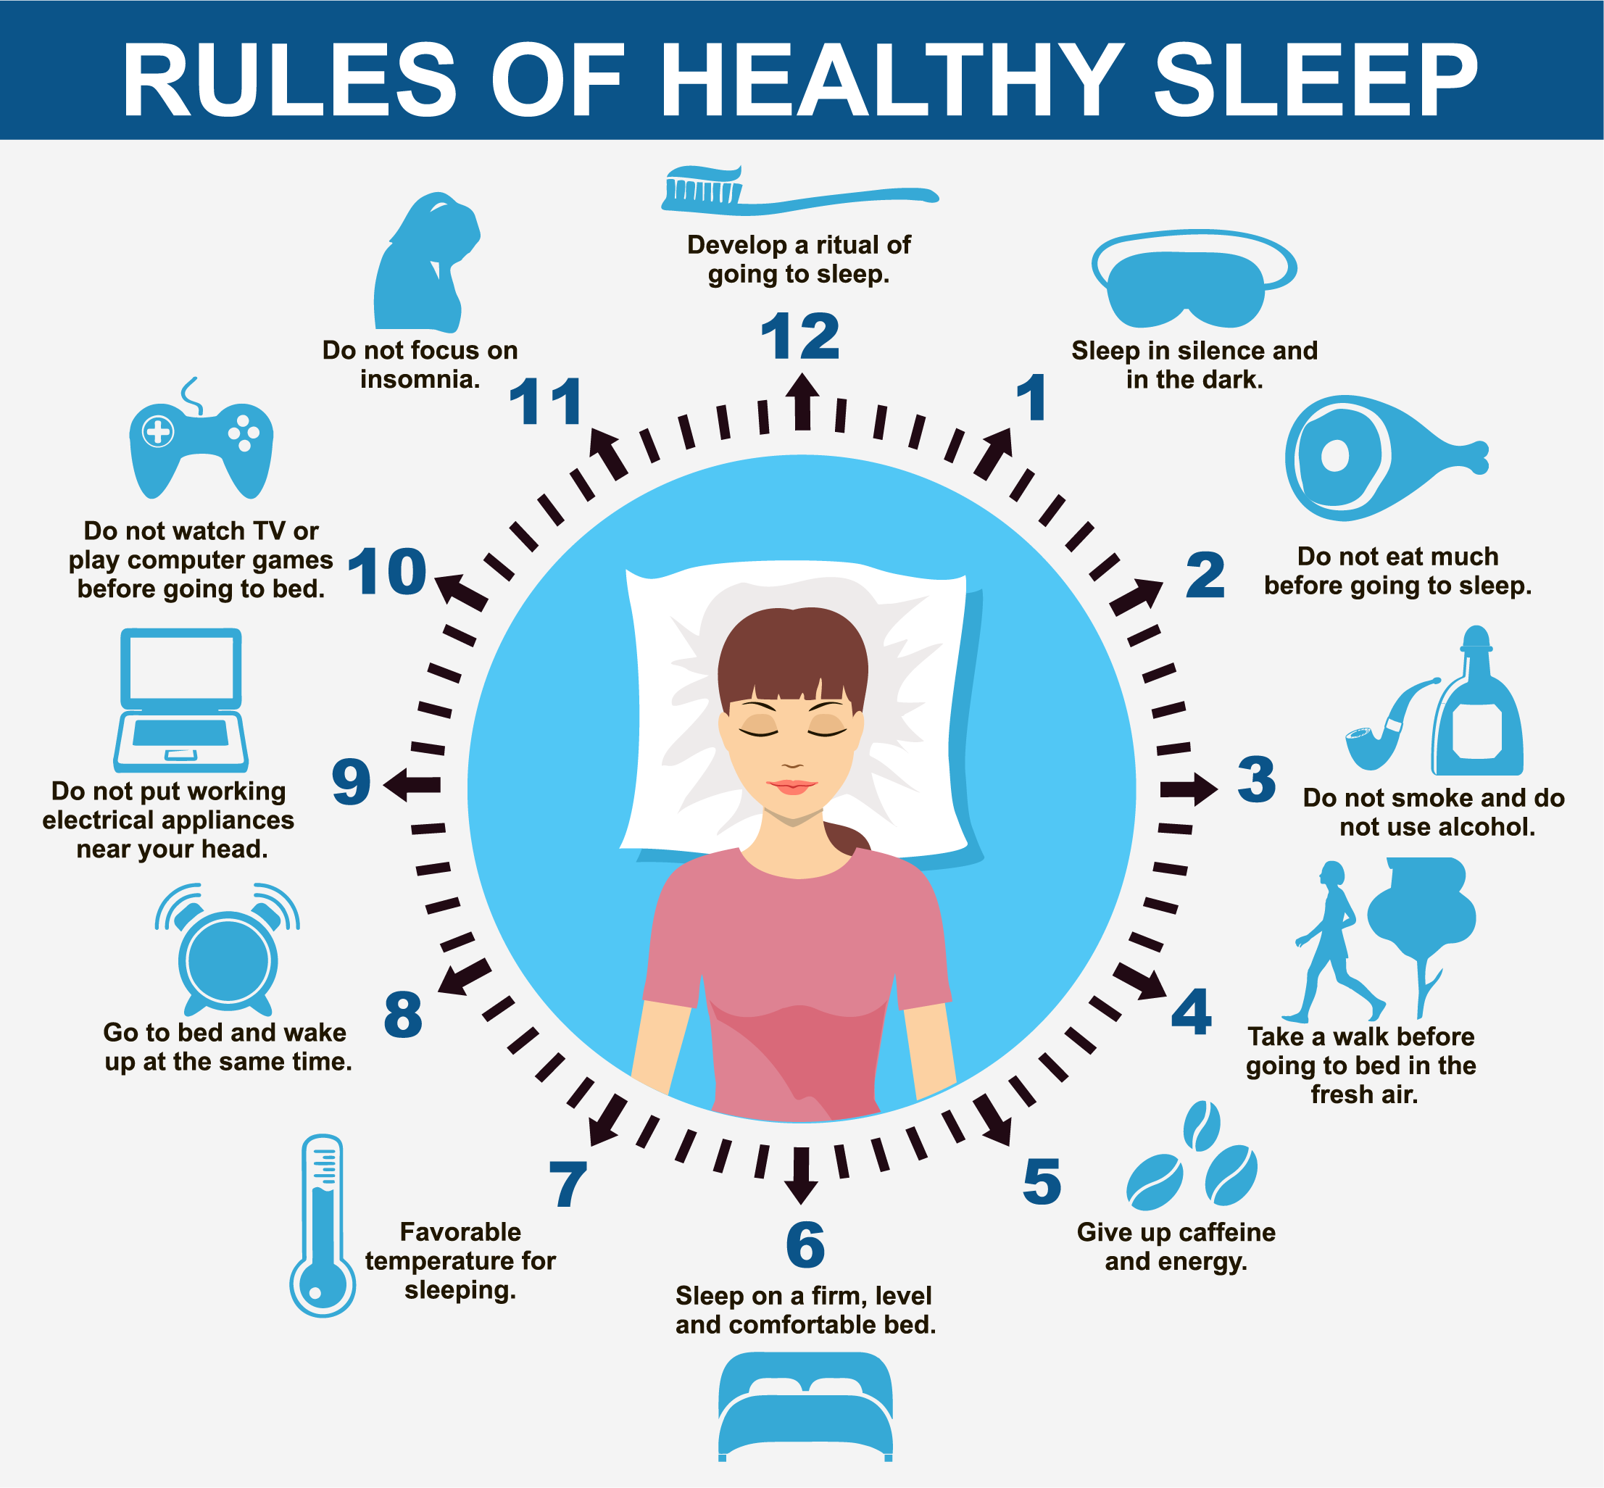

Slide 23
10 habits of Self Discipline (Contd.)
7. Exercise
By instilling the keystone habit of exercise, not only can you become more disciplined, but you can improve your life in a number of ways. First, exercise reduces your levels of stress and pain by releasing endorphins and neurotransmitters such as dopamine and serotonin.
Second, exercise improves health by increasing blood flow and oxygenation of the body’s cells, helping to fight off diseases and boost the immune system. And, of course, exercise increases our ability to focus on the task at hand, allowing us to lead a more disciplined life.
To instill the habit of exercise in your life, start small. Begin by walking around the block for 5 minutes in the morning. Just 5 minutes. Do that for one week. Then, increase it to 10 minutes and do that for a week. And continue with this pattern. Eventually, exercise will become a full-blown habit.

Slide 24

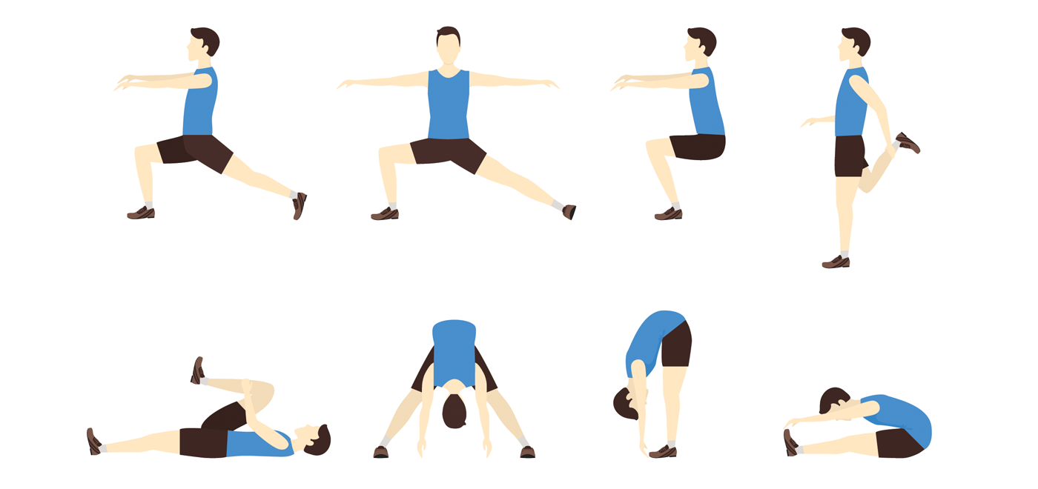

Slide 25

10 habits of Self Discipline (Contd.)
8. Organization
An organized life is a disciplined life. Start small if you label yourself as completely scattered. Begin by organizing one small space each day. For example, start by organizing your desk drawer. The next day, move onto organizing your medicine cabinet in your bathroom. And so on.
Do one small thing a day to improve your organization. That’s all it takes.

Slide 26

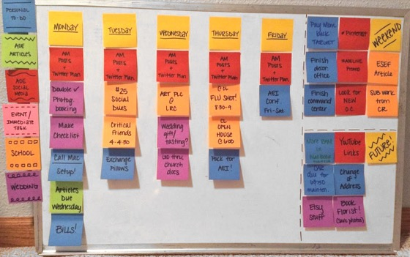
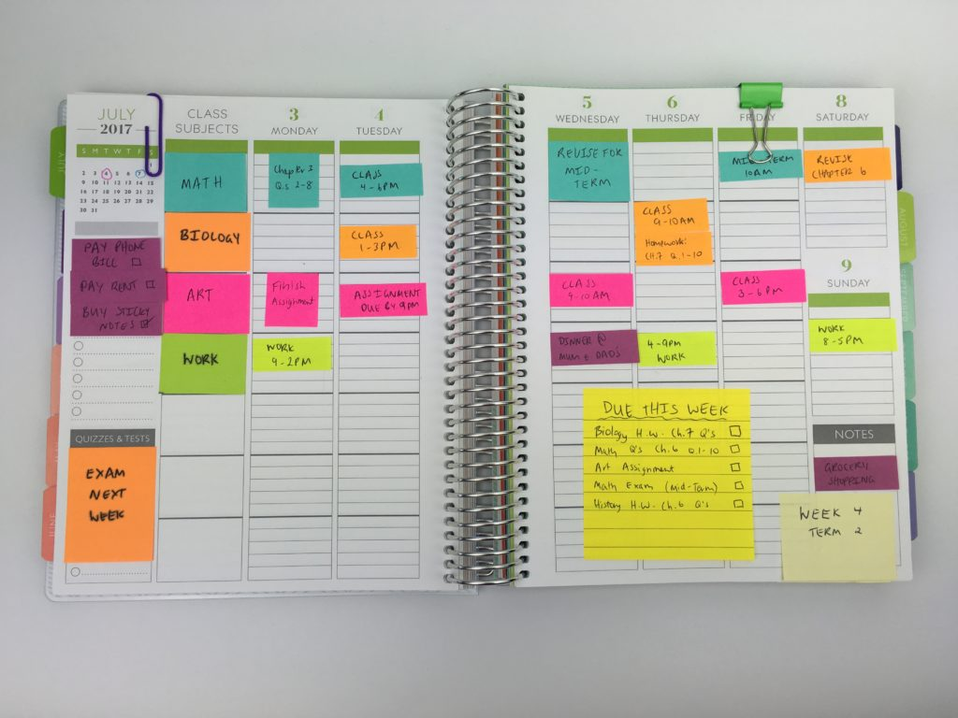


Slide 27
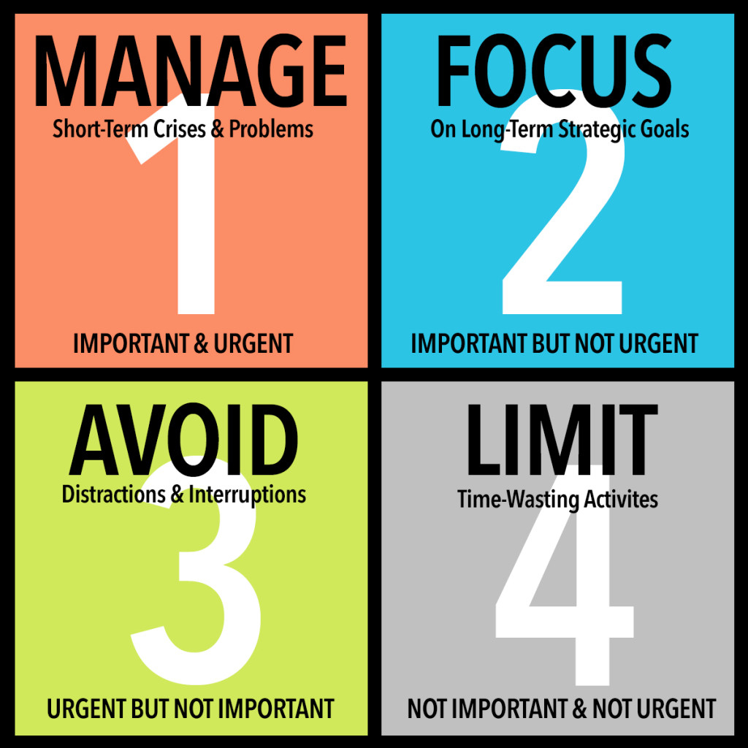
9. Time management
10 habits of Self Discipline (Contd.)

Slide 28
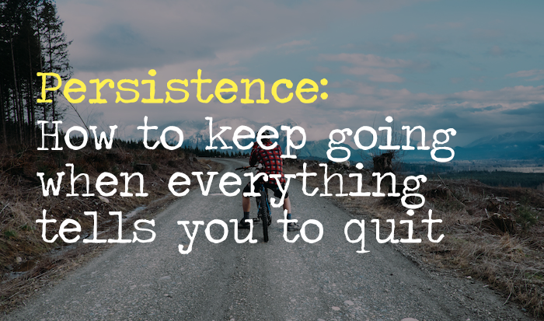
10 habits of Self Discipline (Contd.)
10. Persistence
Persistence is that certain habit that helps us to not give up. Even when we do fail, it allows us to get back up again
achieving our goals is hard. Getting discouraged is easy. And giving up takes far less effort than continuing to push through, especially towards something that inflicts a lot of pain before it provides us with any pleasure.

Slide 29
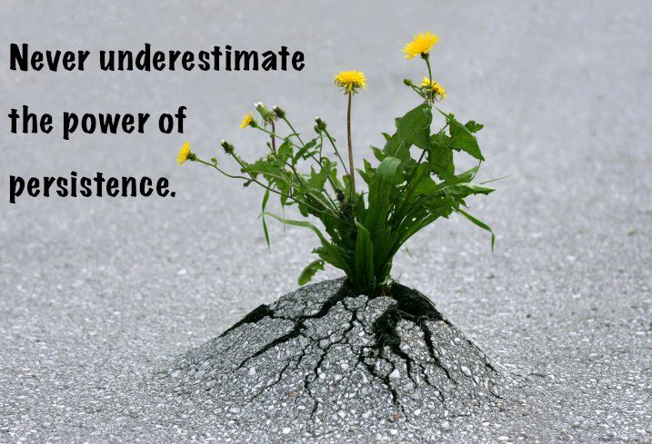

Slide 30
